Slide 1
MGMTEX 421 – International Business Residential in Italy
Prof. Nico Voigtländer
Class 2
Presentations and Debates: Topics on the Italian Economy

Slide 2
Logistics – Schedule from here…
Class today: Discussion of Presentation Debates
Present 2-3 min executive summary
Followed by discussion
Max. 20 minutes per topic
Trip to Italy: Sep 3-9. Schedule
Note: Casual dress code.
Get Melatonin for the jetlag!
Class on Sep 24: Debrief and discussion of student reports

Slide 3
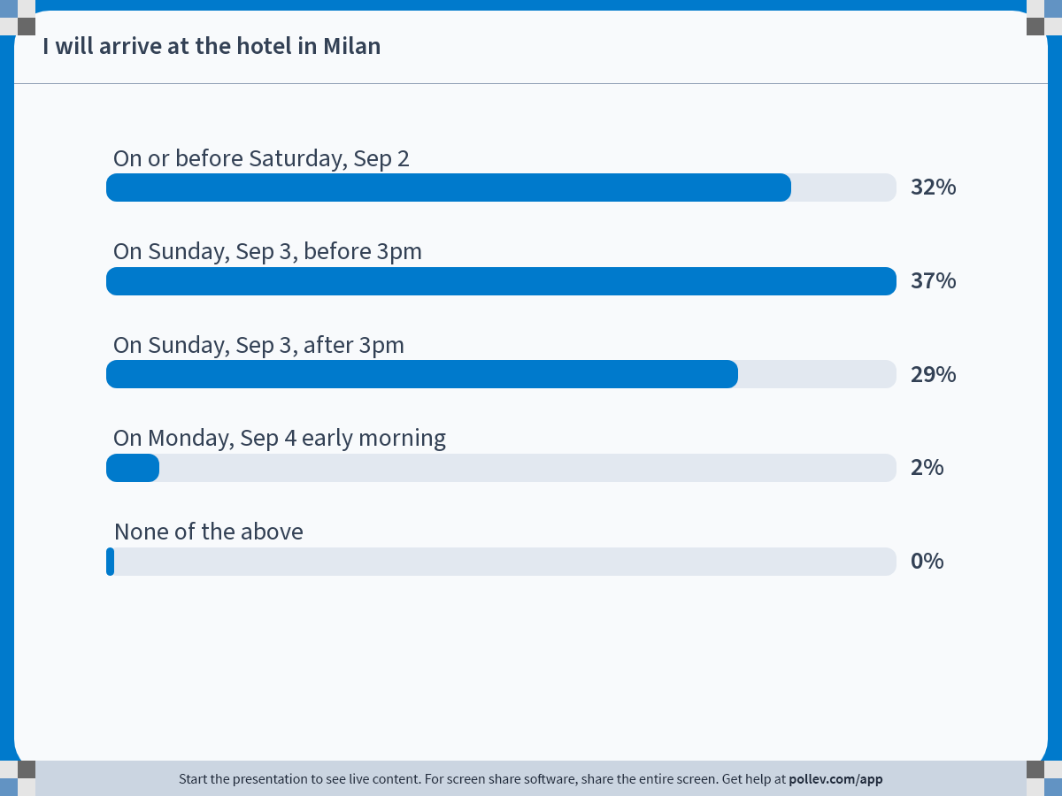
Notes:
Poll Title: Do not modify the notes in this section to avoid tampering with the Poll Everywhere activity. More info at polleverywhere.com/support I will arrive at the hotel in Milan https://www.polleverywhere.com/multiple_choice_polls/W48aUoQdkorGN8CDnd6ue?state=opened&flow=Default&onscreen=persist

Slide 4
Presentations and Discussions

Slide 5
Presentation Topics (i)
Italy's Future in Tech/Services
"Italy can be competitive with a focus on exporting physical goods“
"Italy must become more competitive in tech/services to compete globally"
Corruption and Trust
"Italy's reputation for corruption and low trust is overblown“
"Italy has a serious problem with corruption and low trust, with major negative economic impact"

Slide 6
Presentation Topics (ii)
Immigration and Growth
"Further immigration will have a negative net impact on Italy's economy and political stability“
"Italy should encourage more immigration if it wants to grow its economy"
Lavazza
"Lavazza should create a new brand identity aligned with US consumer tastes"
"Lavazza should introduce US consumers to the 'Italian' way of drinking espresso"

Slide 7
Presentation Topics (iii)
Juventus F.C.
"Private equity will destroy the reputation and history of clubs like Juventus"
"Juve is behind the times – private equity will bring efficiency and modernization"

Slide 8
Backup Slides

Slide 9
